Slide 1
COSC 522: Machine Learning Lecture 1 – Introduction
Fnu Suya
08/18/26

Slide 2

About the instructor
Instructor: Fnu Suya
suya@utk.edu
Office: KMB 344
Office hour: Mon 2:00 pm to 3:00 pm
PhD in CS@UVa, Postdoc@UMD
Research interest:
Trustworthy Machine learning:
How to secure ML in adversarial environments
How to protect data privacy in ML models
ML for Cybersecurity:
How to use ML for accurate and scalable malware detection
How to use ML for network anomaly detection

Slide 3
Logistics: Course Syllabus
https://docs.google.com/document/d/1lYopNzjn_0AOipRiiwO4h2Ow64seQNeD/edit?usp=sharing&ouid=114000599194691965836&rtpof=true&sd=true
This whole section is required reading

Slide 4
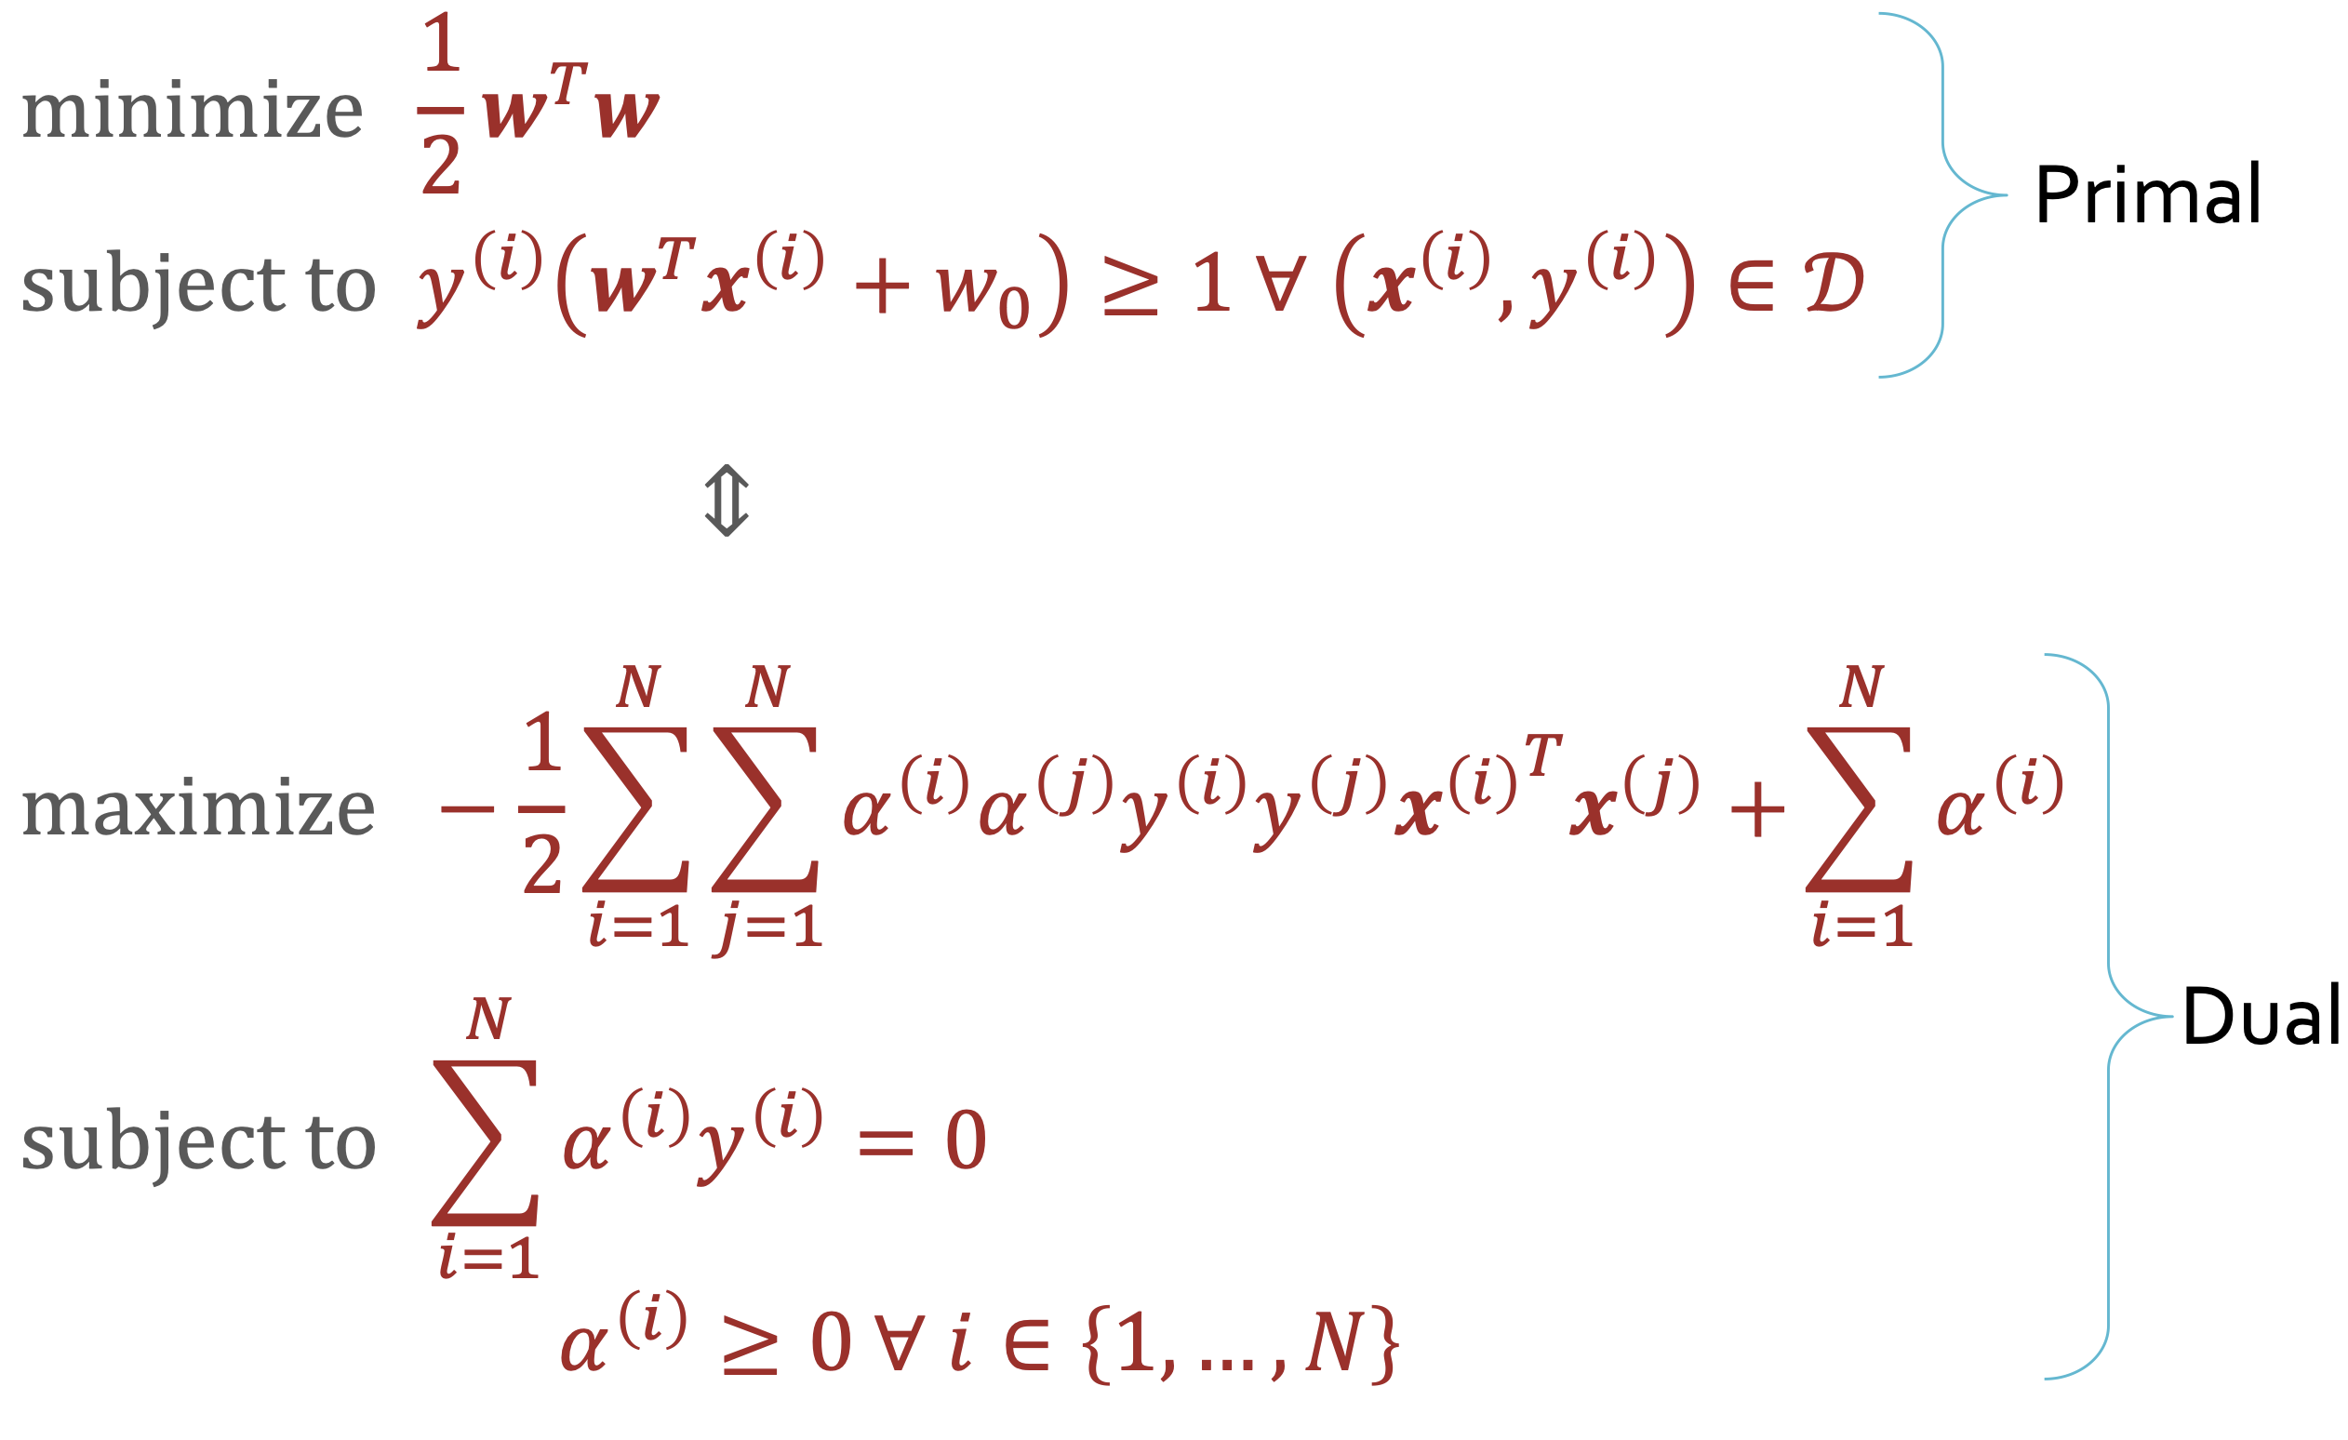
Logistics: Expected course load
This is NOT a course that only teaches you how to import ML packages.
Instead, you should have the foundation to understand the fundamentals of ML and even develop your own packages in future
This course requires good understanding of linear algebra, some knowledge about convex optimization, probability and statistics, as well as good programming skills in Python.

Slide 5
Logistics: Grading
(30% = 3*10%) Homework
Mixture of handwritten problems (some theory) and coding exercise
(30%) Midterm
In-class exam, no paperwork, no internet, calculator allowed
(30%) Final project
ML related project, work with group
(10%) In-class quizzes (5% for attendance, 5% for correctness)
Online and in-class
Bonus points: requires instructor approval
(5%) final project leads to workshop submission
(10%) final project leads to top-conference submission

Slide 6
Logistics: group project
Track 1: Methodological Advancement: Advance ML Science
propose a novel technique
conduct a large-scale empirical study to compare existing methods and obtain new insights.
Track 2: Novel Application: advance ML practice.
build a full-pipeline solution to a real-world problem, requiring data collection, cleaning, and modeling.
analyze scientific data from materials science or building a predictive system for a local Knoxville challenge.
Form the group early:
Sign-up and enter the team information here: https://docs.google.com/spreadsheets/d/1nB7MyunUpibGMdeylvUAN4zY62NdPg9M8suaHcfVxc4/edit?usp=sharing
Deadline to register for groups: Sep 2nd. After, we will randomly group remaining students
Do talk to me once you fix your group and identified the project title.

Slide 7
Logistics: Late Policy
For each homework, students can submit late with the penalty of 25% deduction for every 24 hours late (up to 3 days).
After 3 days, no more late submission is allowed.
Extensions can be granted for special cases (email the instructor)

Slide 8
Logistics: Collaboration Policy
Collaboration on homework assignments is encouraged but must be documented
You must always write your own code/answers
You may not re-use code/previous versions of the homework, whether your own or otherwise
Cannot use LLM to generate answers
0 points if got caught

Slide 9
Logistics: Technologies
Discord, for course discussion:
https://discord.gg/wgTNw872Y
Canvas, for hosting homework assignments, lecture slides, homework submissions
PointSolutions for in-class quizzes:
https://echo360.com/pointsolutions-login/

Slide 10
Logistics: Topics to Cover
ML Basics and Foundation
Modern Deep Learning
Decision Trees
KNNs & Model Selection
Linear Regression
SVM
MLE/MAP
Naïve Bayes
Logistic Regression
Regularization
Learning Theory
Neural Networks
Backpropagation
CNNs, RNNs
Attention & Transformers
Unsupervised Learning (PCA, Clustering)
Reinforcement learning
Pretraining, Fine-tuning, In-context Learning
Generative Models for Vision

Slide 11
What is Machine Learning?

Slide 12
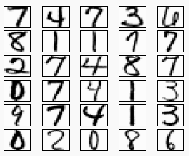

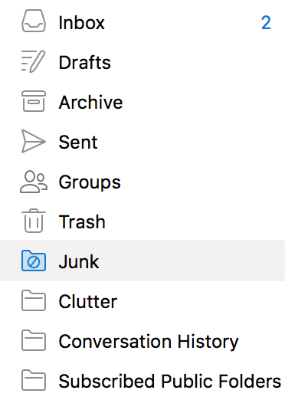
Machine Learning (A long long time ago…)

Slide 13
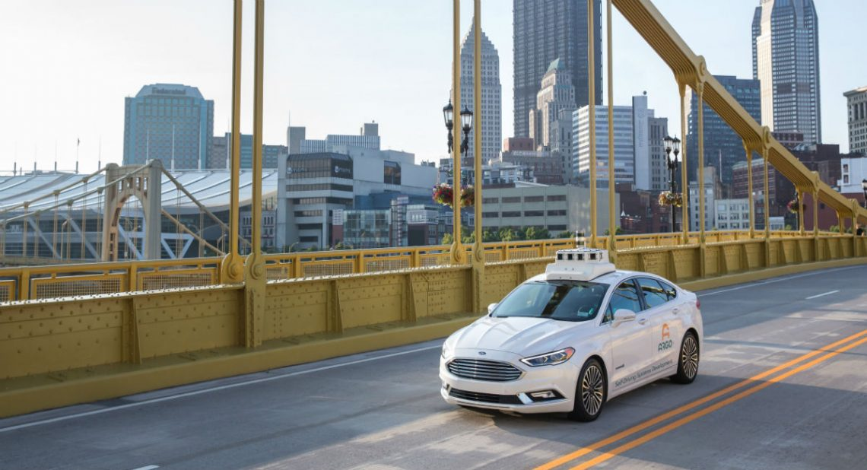

Machine Learning (A short time ago…)

Slide 14
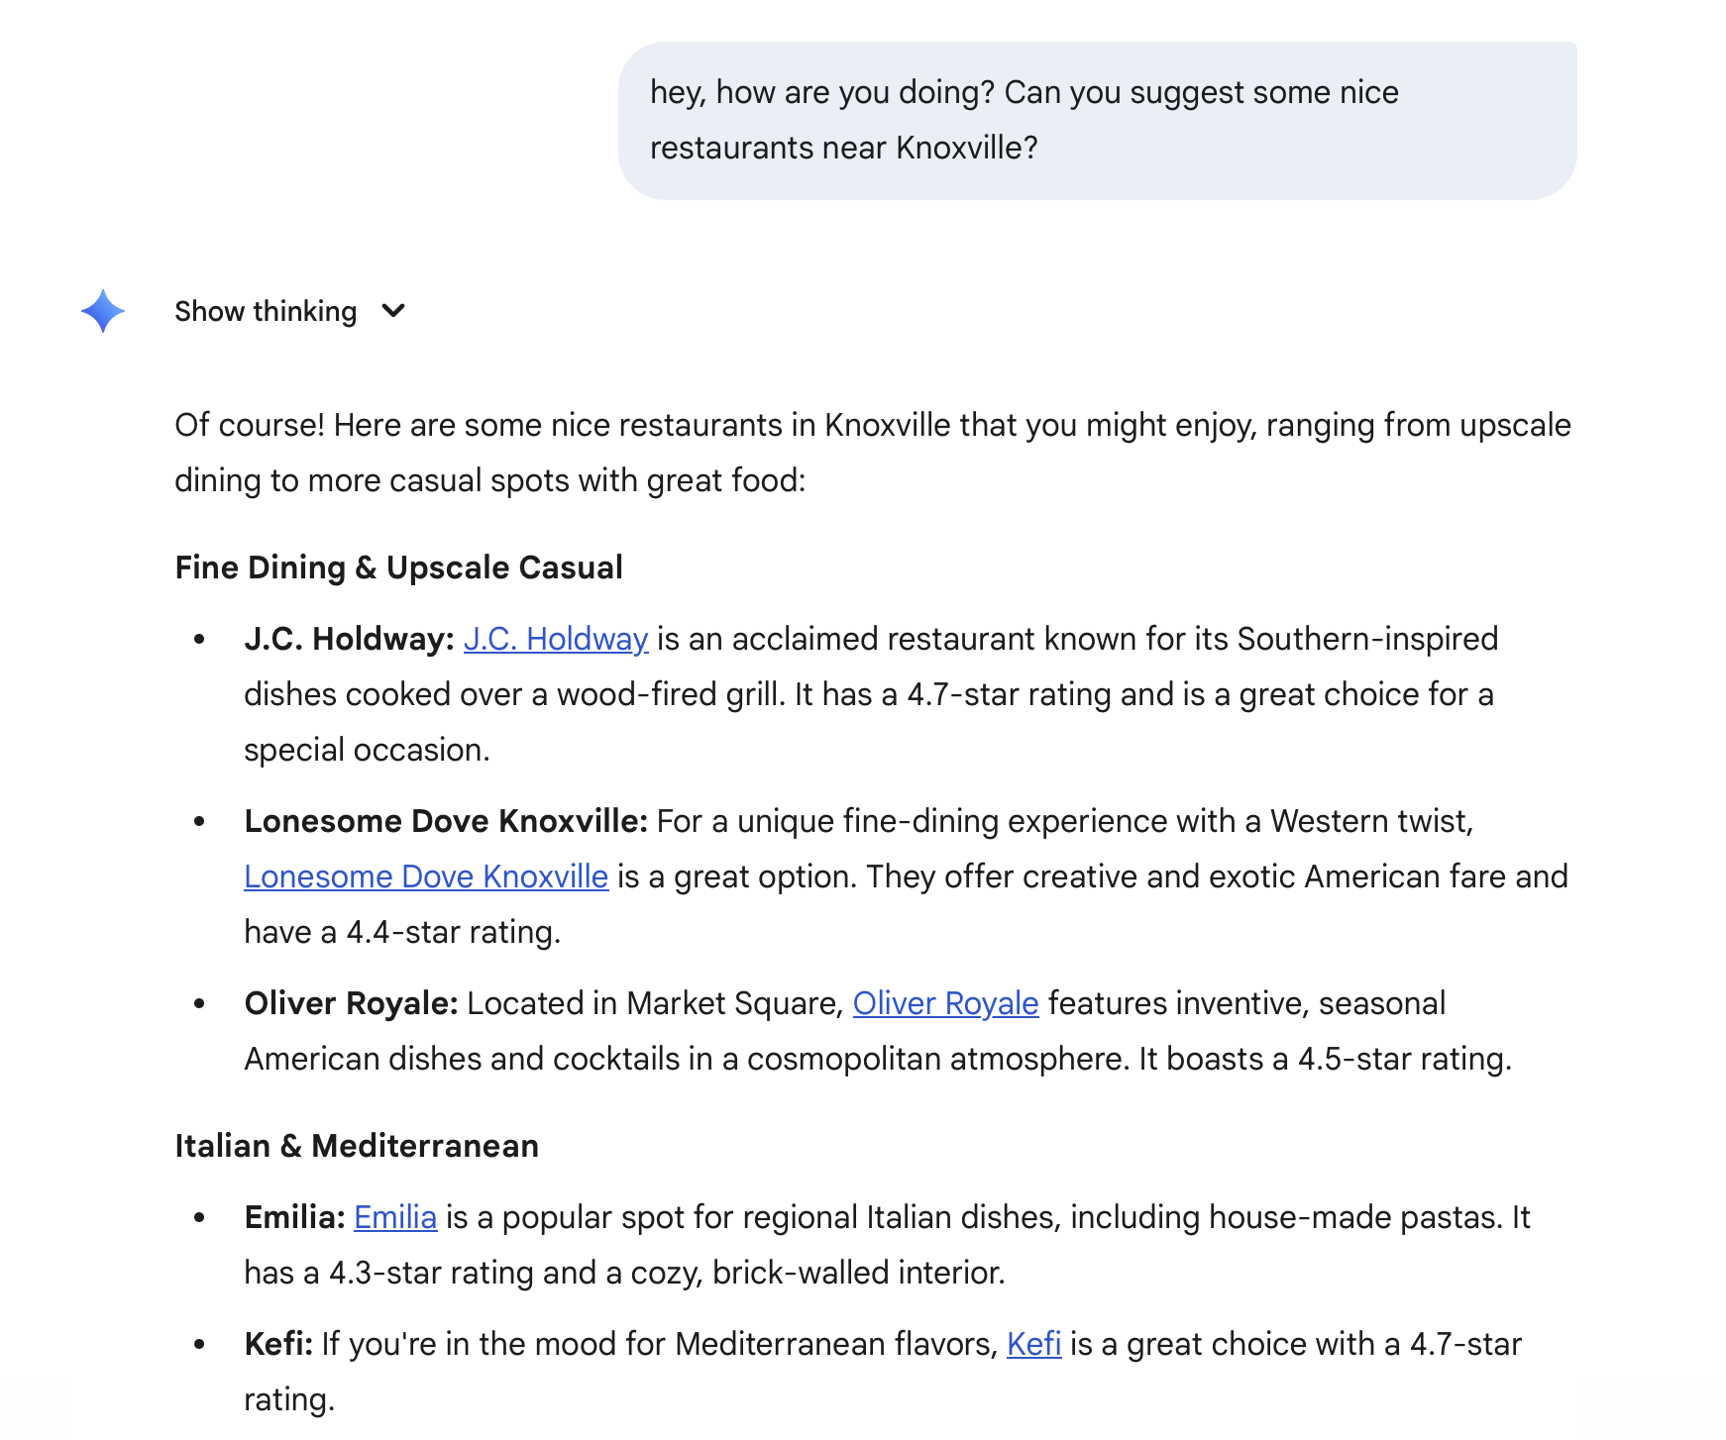
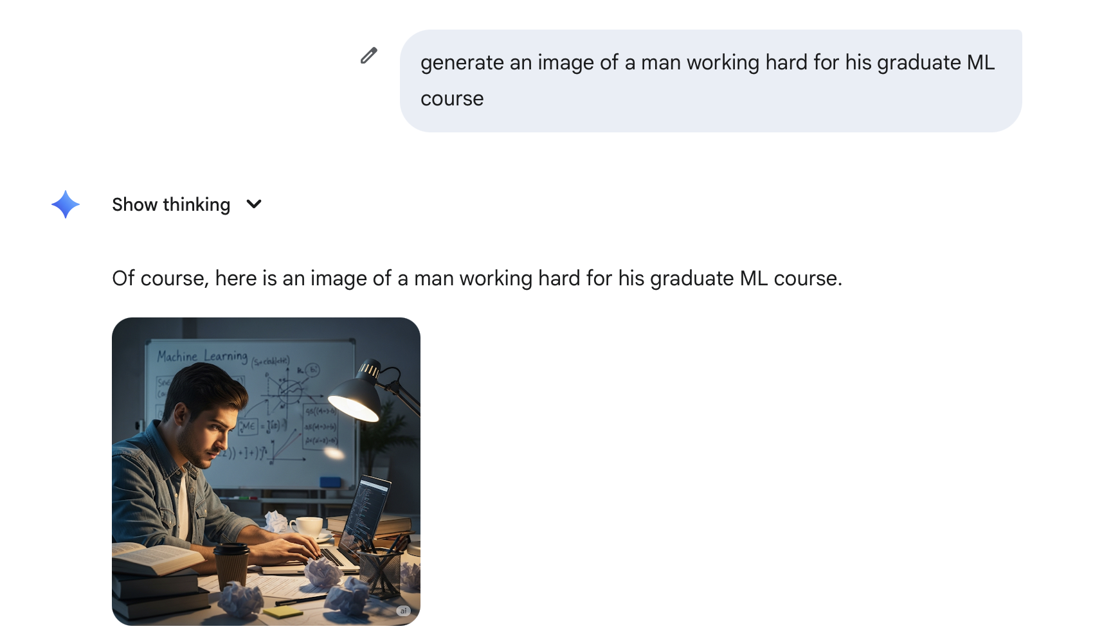

Slide 15
What is Machine Learning
Supervised Models
Decision Trees
KNN
Naïve Bayes
Perceptron
Logistic Regression
Linear Regression
Neural Networks
SVMs
Unsupervised Learning
Ensemble Methods
Graphical Models
Learning Theory
Reinforcement Learning
Deep Learning
Generative AI
Important Concepts
Feature Engineering
Regularization and Overfitting
Experimental Design
Societal Implications

Slide 16
Defining a Machine Learning Task (Mitchell, 97)
A computer program learns if its performance, P, at some task, T, improves with experience, E.
Three components
Task, T
Performance metric, P
Experience, E

Slide 17
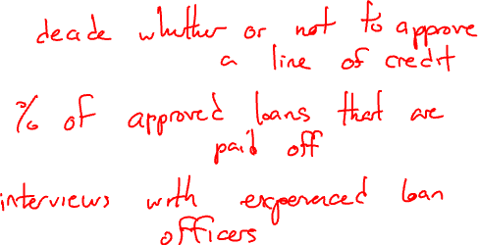
Defining a Machine Learning Task: Example
Learning to approve loans/lines of credit
Three components
Task, T
Decide whether to extend someone a loan
Performance metric, P
Number of people who default on their loan
Experience, E
Interviews with loan officers

Slide 18
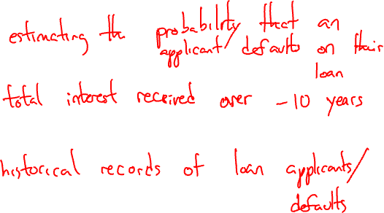
Defining a Machine Learning Task: Example
Learning to approve loans/lines of credit
Three components
Task, T
Predict the probability someone defaults on a loan
Performance metric, P
Amount of money (interest) made
Experience, E
Historical data on loan defaults

Slide 19
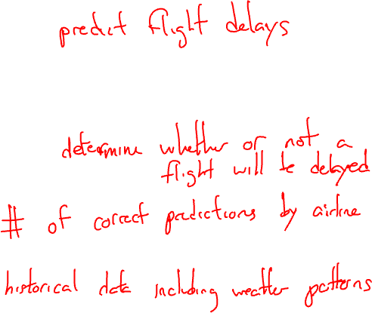
Defining a Machine Learning Task: Example
Learning to
Three components
Task, T
Performance metric, P
Experience, E

Slide 20
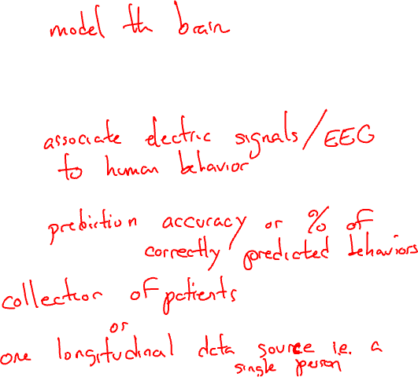
Defining a Machine Learning Task: Example
Learning to
Three components
Task, T
Performance metric, P
Experience, E

Slide 21
Our first Machine Learning Task
Learning to diagnose heart disease
as a (supervised) binary classification task
features
labels
Family History | Resting Blood Pressure | Cholesterol | Heart Disease?
Yes | Low | Normal | No
No | Medium | Normal | No
No | Low | Abnormal | Yes
Yes | Medium | Normal | Yes
Yes | High | Abnormal | Yes
data points

Slide 22
Our first Machine Learning Task
Learning to diagnose heart disease
as a (supervised) binary classification task
features
labels
Family History | Resting Blood Pressure | Cholesterol | Heart Disease?
Yes | Low | Normal | No
No | Medium | Normal | No
No | Low | Abnormal | Yes
Yes | Medium | Normal | Yes
Yes | High | Abnormal | Yes
data points

Slide 23
Our first Machine Learning Task
Learning to diagnose heart disease
as a (supervised) binary classification task
features
labels
Family History | Resting Blood Pressure | Cholesterol | Heart Disease?
Yes | Low | Normal | No
No | Medium | Normal | No
No | Low | Abnormal | Yes
Yes | Medium | Normal | Yes
Yes | High | Abnormal | Yes
data points

Slide 24
Our first Machine Learning Task
Learning to diagnose heart disease
as a (supervised) binary classification task
features
labels
Family History | Resting Blood Pressure | Cholesterol | Risk
Yes | Low | Normal | Low Risk
No | Medium | Normal | Low Risk
No | Low | Abnormal | Medium Risk
Yes | Medium | Normal | High Risk
Yes | High | Abnormal | High Risk
data points

Slide 25
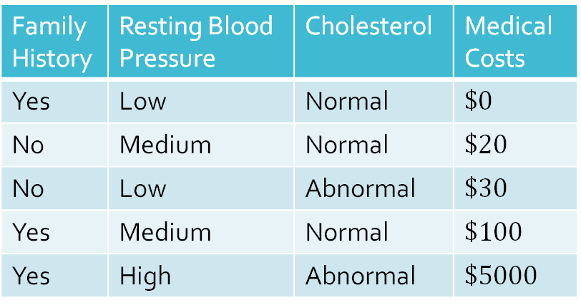
Our first Machine Learning Task
Learning to diagnose heart disease
as a (supervised) bin. . ary regression task
features
targets
Family History | Resting Blood Pressure | Cholesterol | Medical Costs
Yes | Low | Normal | $$\$0$$
No | Medium | Normal | $$\$20$$
No | Low | Abnormal | $$\$30$$
Yes | Medium | Normal | $$\$100$$
Yes | High | Abnormal | $$\$5000$$
data points

Slide 26
Our first Machine Learning Classifier
A classifier is a function that takes feature values as input and outputs a label
Majority vote classifier: always predict the most common label in the training dataset
features
labels
Family History | Resting Blood Pressure | Cholesterol | Heart Disease?
Yes | Low | Normal | No
No | Medium | Normal | No
No | Low | Abnormal | Yes
Yes | Medium | Normal | Yes
Yes | High | Abnormal | Yes
data points

Slide 27
Is this a “good” Classifier?
A classifier is a function that takes feature values as input and outputs a label
Majority vote classifier: always predict the most common label in the training dataset
features
labels
Family History | Resting Blood Pressure | Cholesterol | Heart Disease?
Yes | Low | Normal | No
No | Medium | Normal | No
No | Low | Abnormal | Yes
Yes | Medium | Normal | Yes
Yes | High | Abnormal | Yes
data points

Slide 28
Training vs. Testing
A classifier is a function that takes feature values as input and outputs a label
Majority vote classifier: always predict the most common label in the training dataset (Yes)
Family History | Resting Blood Pressure | Cholesterol | Heart Disease?
Yes | Low | Normal | No
No | Medium | Normal | No
No | Low | Abnormal | Yes
Yes | Medium | Normal | Yes
Yes | High | Abnormal | Yes
training dataset

Slide 29
Training vs. Testing
A classifier is a function that takes feature values as input and outputs a label
Majority vote classifier: always predict the most common label in the training dataset (Yes)
A test dataset is used to evaluate a classifier’s predictions
The error rate is the proportion of data points where the prediction is wrong
Family History | Resting Blood Pressure | Cholesterol | Heart Disease? | Predictions
No | Low | Normal | No | Yes
No | High | Abnormal | Yes | Yes
Yes | Medium | Abnormal | Yes | Yes
test dataset

Slide 30
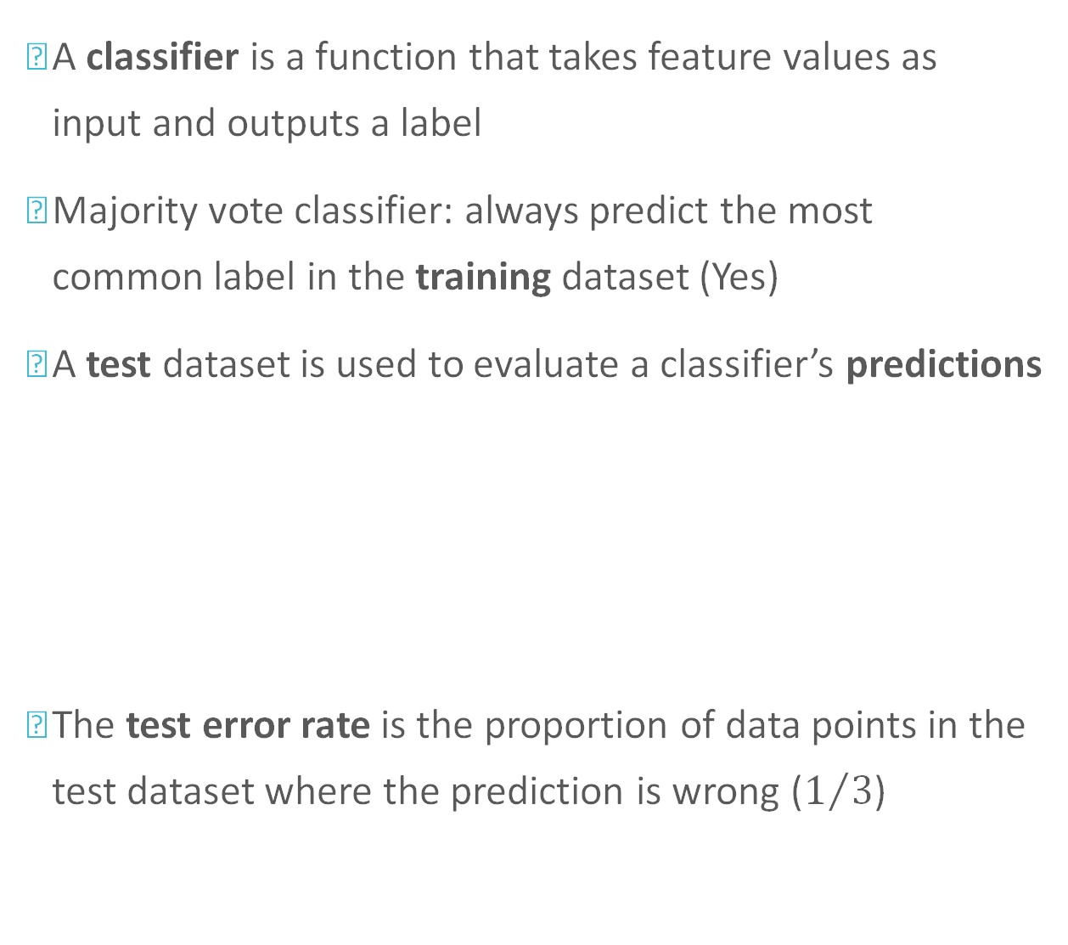
Training vs. Testing
A classifier is a function that takes feature values as input and outputs a label
Majority vote classifier: always predict the most common label in the training dataset (Yes)
A test dataset is used to evaluate a classifier’s predictions
The test error rate is the proportion of data points in the test dataset where the prediction is wrong ($1/3$)
Family History | Resting Blood Pressure | Cholesterol | Heart Disease? | Predictions
No | Low | Normal | No | Yes
No | High | Abnormal | Yes | Yes
Yes | Medium | Abnormal | Yes | Yes
test dataset

Slide 31
A Typical (Supervised) Machine Learning Routine
Step 1 – training
Input: a labelled training dataset
Output: a classifier
Step 2 – testing
Inputs: a classifier, a test dataset
Output: predictions for each test data point
Step 3 – evaluation
Inputs: predictions from step 2, test dataset labels
Output: some measure of how good the predictions are; usually (but not always) error rate

Slide 32
Our first Machine Learning Classifier
A classifier is a function that takes feature values as input and outputs a label
Majority vote classifier: always predict the most common label in the training dataset
This classifier completely ignores the features…
features
labels
Family History | Resting Blood Pressure | Cholesterol | Heart Disease?
Yes | Low | Normal | No
No | Medium | Normal | No
No | Low | Abnormal | Yes
Yes | Medium | Normal | Yes
Yes | High | Abnormal | Yes
data points

Slide 33
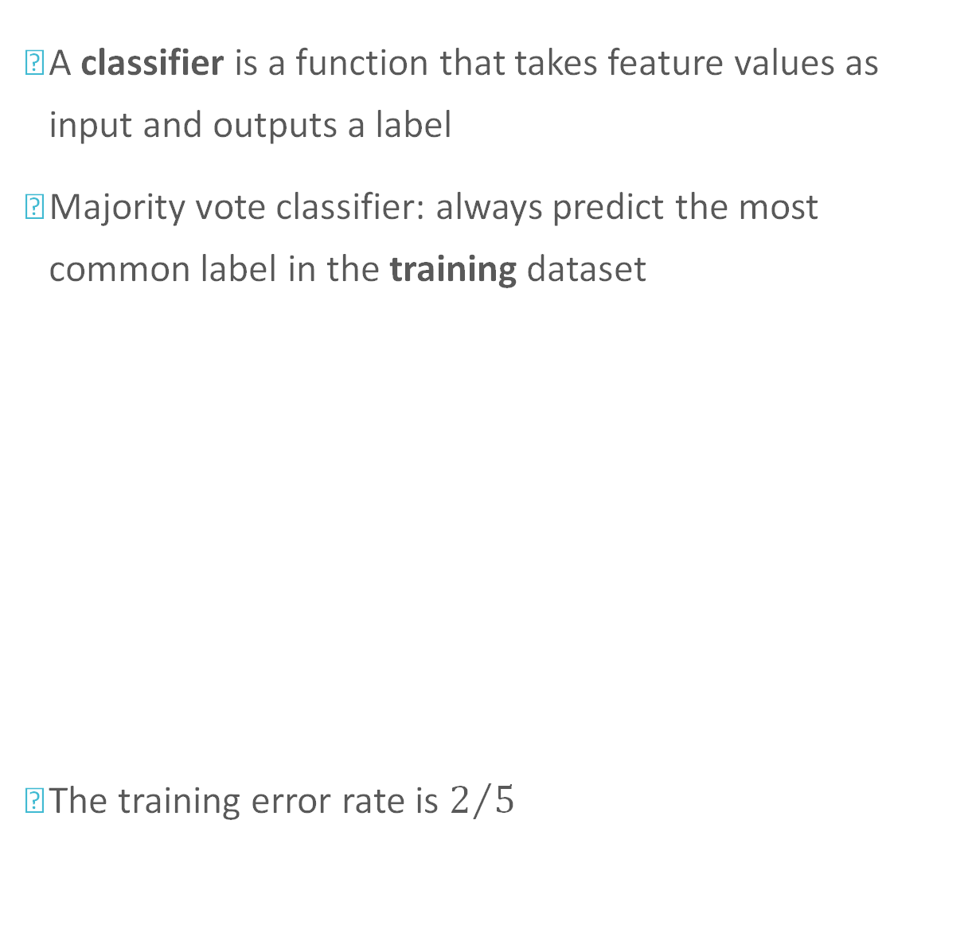
Our first Machine Learning Classifier
A classifier is a function that takes feature values as input and outputs a label
Majority vote classifier: always predict the most common label in the training dataset
The training error rate is $2/5$
features
labels
Family History | Resting Blood Pressure | Cholesterol | Heart Disease? | Predictions
Yes | Low | Normal | No | Yes
No | Medium | Normal | No | Yes
No | Low | Abnormal | Yes | Yes
Yes | Medium | Normal | Yes | Yes
Yes | High | Abnormal | Yes | Yes
data points

Slide 34
Our second Machine Learning Classifier
A classifier is a function that takes feature values as input and outputs a label
Memorizer: if a set of features exists in the training dataset, predict its corresponding label; otherwise, predict the majority vote
Family History | Resting Blood Pressure | Cholesterol | Heart Disease?
Yes | Low | Normal | No
No | Medium | Normal | No
No | Low | Abnormal | Yes
Yes | Medium | Normal | Yes
Yes | High | Abnormal | Yes

Slide 35

Our second Machine Learning Classifier
A classifier is a function that takes feature values as input and outputs a label
Memorizer: if a set of features exists in the training dataset, predict its corresponding label; otherwise, predict the majority vote
The training error rate is $0$!
Family History | Resting Blood Pressure | Cholesterol | Heart Disease? | Predictions
Yes | Low | Normal | No | No
No | Medium | Normal | No | No
No | Low | Abnormal | Yes | Yes
Yes | Medium | Normal | Yes | Yes
Yes | High | Abnormal | Yes | Yes

Slide 36
Is the memorizer learning?
A classifier is a function that takes feature values as input and outputs a label
Memorizer: if a set of features exists in the training dataset, predict its corresponding label; otherwise, predict the majority vote
The training error rate is $0$!
Family History | Resting Blood Pressure | Cholesterol | Heart Disease? | Predictions
Yes | Low | Normal | No | No
No | Medium | Normal | No | No
No | Low | Abnormal | Yes | Yes
Yes | Medium | Normal | Yes | Yes
Yes | High | Abnormal | Yes | Yes

Slide 37
Our second Machine Learning Classifier
A classifier is a function that takes feature values as input and outputs a label
Memorizer: if a set of features exists in the training dataset, predict its corresponding label; otherwise, predict the majority vote
The memorizer (typically) does not generalize well, i.e., it does not perform well on unseen data points
In some sense, good generalization, i.e., the ability to make accurate predictions given a small training dataset, is the whole point of machine learning!

Slide 38
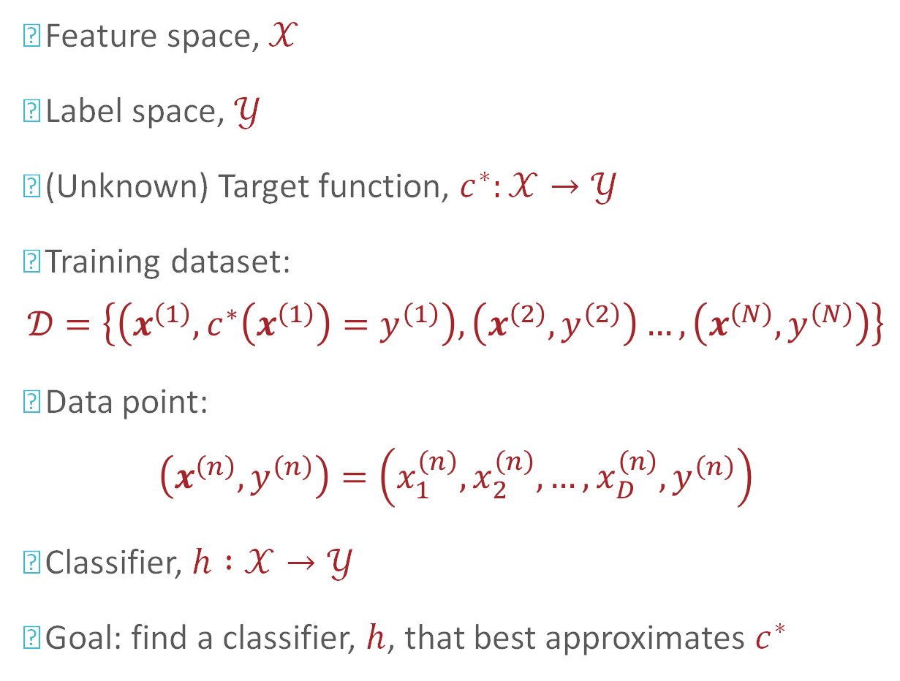
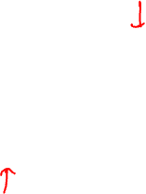
Notation
Feature space, $𝒳$
Label space, $𝒴$
(Unknown) Target function, $c^{∗}:𝒳→𝒴$
Training dataset:
$$𝒟=\left\{\left(x^{\left(1\right)},c^{∗}\left(x^{\left(1\right)}\right)=y^{\left(1\right)}\right),\left(x^{\left(2\right)},y^{\left(2\right)}\right)…,\left(x^{\left(N\right)},y^{\left(N\right)}\right)\right\}$$
Data point:
$$\left(x^{\left(n\right)},y^{\left(n\right)}\right)=\left(x_{1}^{\left(n\right)},x_{2}^{\left(n\right)},…,x_{D}^{\left(n\right)},y^{\left(n\right)}\right)$$
Classifier, $h :𝒳→𝒴$
Goal: find a classifier, $h$, that best approximates $c^{∗}$

Slide 39
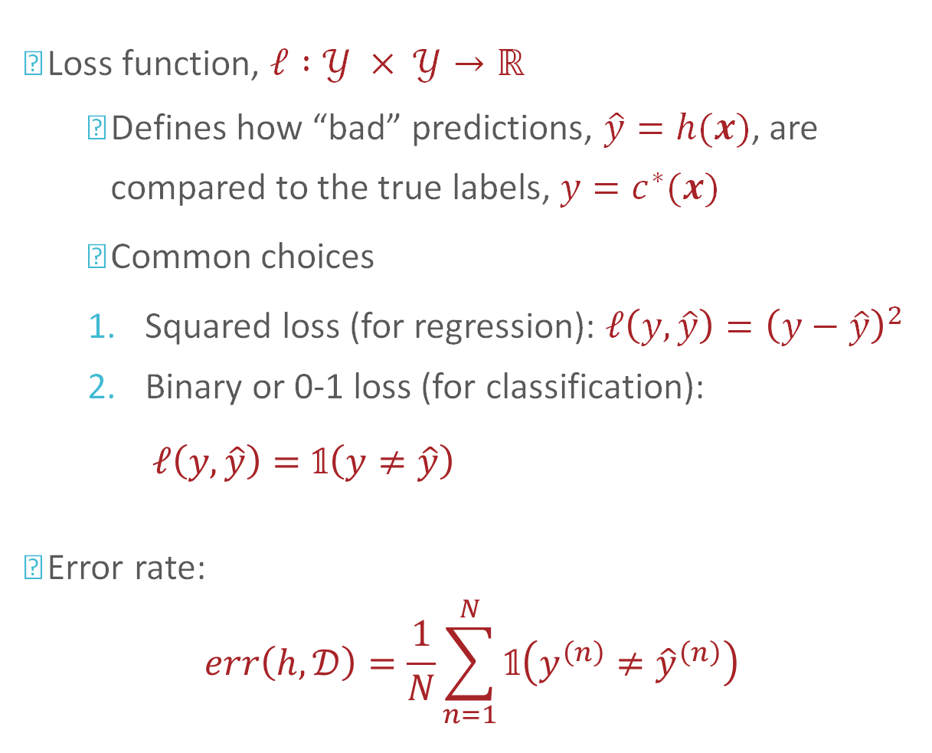
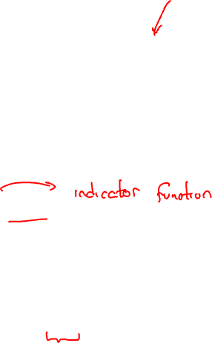
Notation
Loss function, $ℓ :𝒴 × 𝒴→ℝ$
Defines how “bad” predictions, $\hat{y}=h(x)$, are compared to the true labels, $y=c^{∗}(x)$
Common choices
Squared loss (for regression): $ℓ\left(y,\hat{y}\right)={\left(y−\hat{y}\right)}^{2}$
Binary or 0-1 loss (for classification): $ℓ\left(y,\hat{y}\right)=\text{𝟙}\left(y≠\hat{y}\right)=\left\{\begin{aligned}1 if y≠\hat{y} \\ 0 otherwise\end{aligned}\right.$
Error rate:
$$err\left(h,𝒟\right)=\frac{1}{N}\sum_{n=1}^{N}{\text{𝟙}\left(y^{\left(n\right)}≠{\hat{y}}^{\left(n\right)}\right)}$$

Slide 40


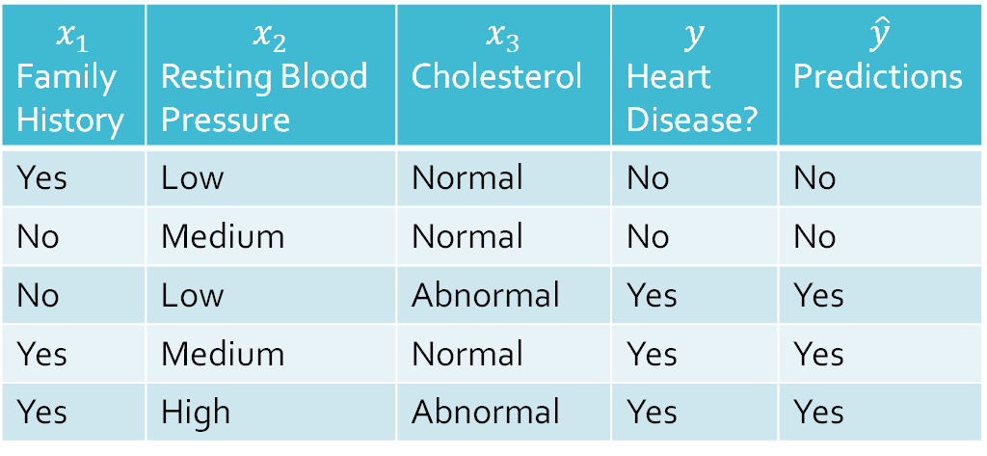
Notation: Example
$N=5$ and $D=3$
$x^{\left(2\right)}=\left(x_{1}^{\left(2\right)}=“No”,x_{2}^{\left(2\right)}=“Medium”,x_{3}^{\left(2\right)}=“Normal”\right)$
$$x_{1}$$ Family History | $$x_{2}$$ Resting Blood Pressure | $$x_{3}$$ Cholesterol | $$y$$ Heart Disease? | $$\hat{y}$$ Predictions
Yes | Low | Normal | No | No
No | Medium | Normal | No | No
No | Low | Abnormal | Yes | Yes
Yes | Medium | Normal | Yes | Yes
Yes | High | Abnormal | Yes | Yes
$$x^{\left(2\right)}$$

Slide 41
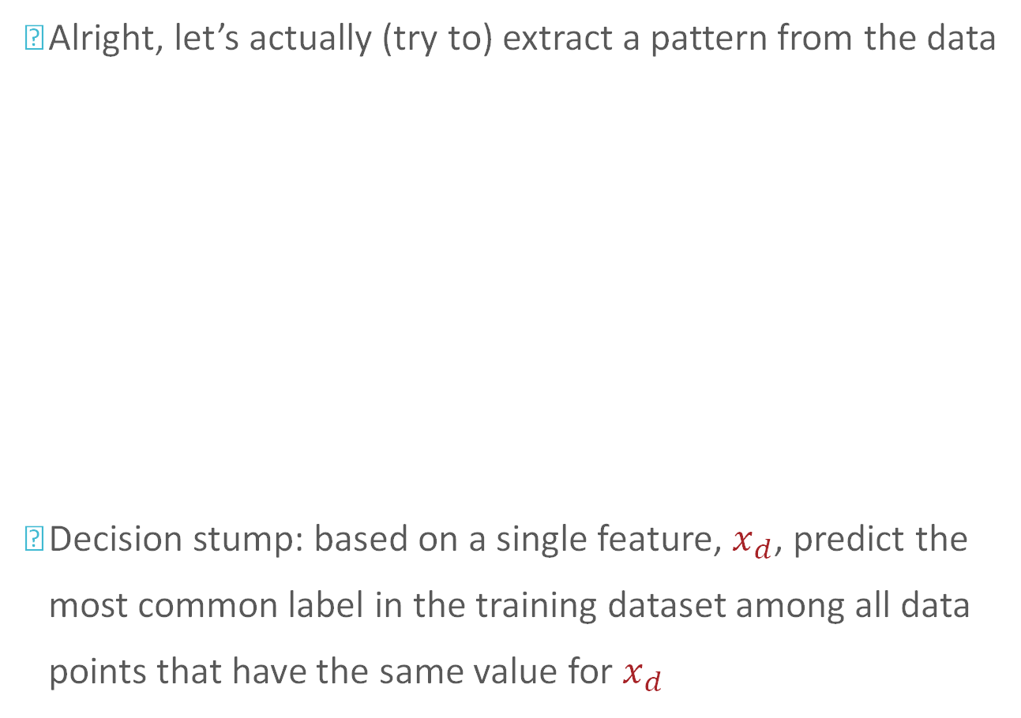
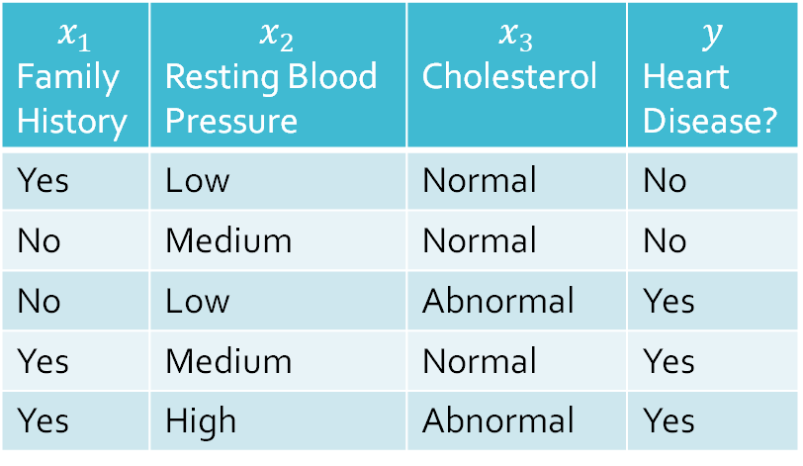
Our third Machine Learning Classifier
Alright, let’s actually (try to) extract a pattern from the data
Decision stump: based on a single feature, $x_{d}$, predict the most common label in the training dataset among all data points that have the same value for $x_{d}$
$$x_{1}$$ Family History | $$x_{2}$$ Resting Blood Pressure | $$x_{3}$$ Cholesterol | $$y$$ Heart Disease?
Yes | Low | Normal | No
No | Medium | Normal | No
No | Low | Abnormal | Yes
Yes | Medium | Normal | Yes
Yes | High | Abnormal | Yes

Slide 42


Our third Machine Learning Classifier: example
Alright, let’s actually (try to) extract a pattern from the data
Decision stump on $x_{1}$: $h\left(x^{′}\right)=h\left(x_{1}^{′},…,x_{D}^{′}\right)=\left\{\begin{aligned}??? if x_{1}^{′}=“Yes” \\ ??? otherwise \end{aligned}\right.$
$$x_{1}$$ Family History | $$x_{2}$$ Resting Blood Pressure | $$x_{3}$$ Cholesterol | $$y$$ Heart Disease?
Yes | Low | Normal | No
No | Medium | Normal | No
No | Low | Abnormal | Yes
Yes | Medium | Normal | Yes
Yes | High | Abnormal | Yes

Slide 43

Our third Machine Learning Classifier: example
Alright, let’s actually (try to) extract a pattern from the data
Decision stump on $x_{1}$: $h\left(x^{′}\right)=h\left(x_{1}^{′},…,x_{D}^{′}\right)=\left\{\begin{aligned}“Yes” if x_{1}^{′}=“Yes” \\ ??? otherwise \end{aligned}\right.$
$$x_{1}$$ Family History | $$x_{2}$$ Resting Blood Pressure | $$x_{3}$$ Cholesterol | $$y$$ Heart Disease?
Yes | Low | Normal | No
No | Medium | Normal | No
No | Low | Abnormal | Yes
Yes | Medium | Normal | Yes
Yes | High | Abnormal | Yes

Slide 44

Our third Machine Learning Classifier: example
Alright, let’s actually (try to) extract a pattern from the data
Decision stump on $x_{1}$: $h\left(x^{′}\right)=h\left(x_{1}^{′},…,x_{D}^{′}\right)=\left\{\begin{aligned}“Yes” if x_{1}^{′}=“Yes” \\ “No” otherwise \end{aligned}\right.$
$$x_{1}$$ Family History | $$x_{2}$$ Resting Blood Pressure | $$x_{3}$$ Cholesterol | $$y$$ Heart Disease?
Yes | Low | Normal | No
No | Medium | Normal | No
No | Low | Abnormal | Yes
Yes | Medium | Normal | Yes
Yes | High | Abnormal | Yes

Slide 45



Our third Machine Learning Classifier: example
Alright, let’s actually (try to) extract a pattern from the data
$$h\left(x\right)=h\left(x_{1},…,x_{d}\right)=\left\{\begin{aligned}“Yes” if x_{1}=“Yes” \\ “No” otherwise \end{aligned}\right.$$
$$x_{1}$$ Family History | $$x_{2}$$ Resting Blood Pressure | $$x_{3}$$ Cholesterol | $$y$$ Heart Disease? | $$\hat{y}$$ Predictions
Yes | Low | Normal | No | Yes
No | Medium | Normal | No | No
No | Low | Abnormal | Yes | No
Yes | Medium | Normal | Yes | Yes
Yes | High | Abnormal | Yes | Yes
$$x_{1}$$
“Yes”
“No”
“Yes”
“No”

Slide 46
Decision Stumps: Questions
How can we pick which feature to split on?
Why stop at just one feature?

Slide 47
Key Takeaways
Components of a machine learning problem
Components of a labelled dataset for supervised learning
Training vs. test datasets
Majority vote classifier
Decision stumps

Slide 48
Acknowledgement
This lecture slides adapted from the materials shared by Prof. Henry Chai at CMU.

